Slide 1
SURFBRD
Michael Margel
Dec 2 2013
CSC 2524

Slide 2
What is SURFBRD?
SURFace-Based Remote Desktop
  Pronounced “Surfboard”
A desktop environment that allows users to quickly and easily move their desktops (virtual workspaces) from one physical workstation to another, as well as enable them to easily share files with other users

Slide 3
Context of Use
To be used in a team-based environment, where the group may need to split into smaller groups in order to accomplish a task and then regroup
Designed to allow users to take their virtual workspaces with them when they move to a new physical workspace
  For instance, when the group splits up
Designed to allow easy sharing and synchronization of files
  For sharing between groups

Slide 4
Hardware
SUR40 (Surface 2.0)
Windows 7
.NET 4.5
Keyboard recommended

Slide 5
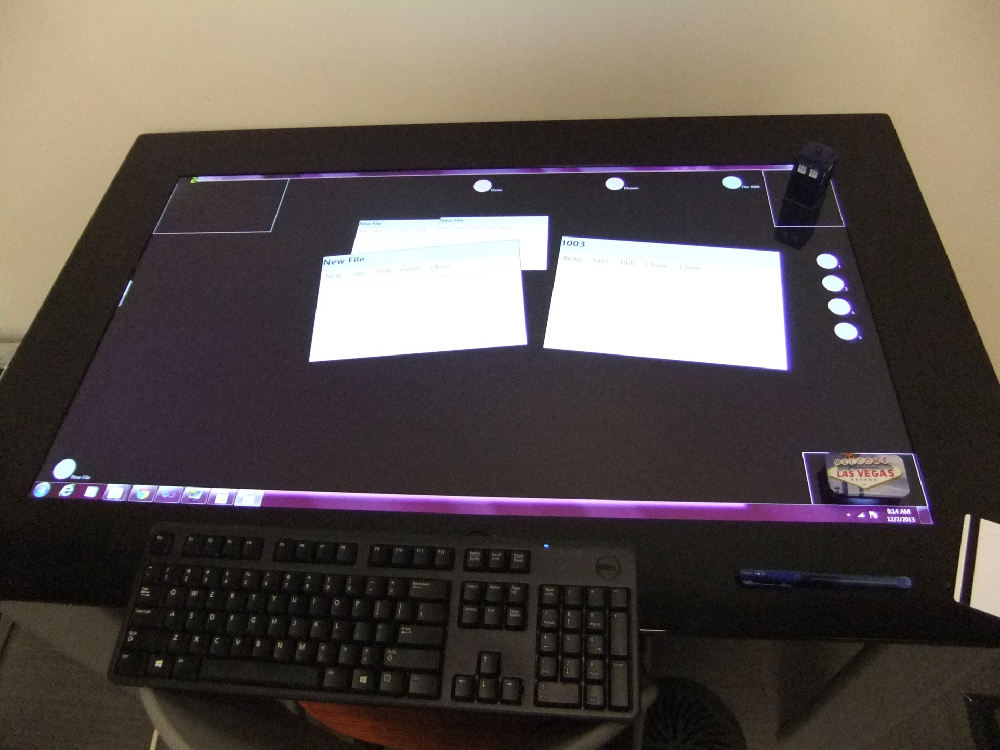

Slide 6
Motivating Papers
i-LAND: An interactive Landscape for Creativity and Innovation (Streitz et al, 1999)
  Introduced idea of a continuous workspace, where users could easily transfer files between workspaces (eg. Move an image from a laptop to a wall display)
  Also introduced the idea of a “bridge” – a physical object that can be used to transfer a file from one device to another

Slide 7
Motivating Papers
Augmenting Interactive Tables with Mice & Keyboards (Hartmann et al, 2008)
  Paper discussed in class, showing ways that a keyboard can be used to augment the abilities of interactive tables
  Introduced the idea of using the keyboard as a tool to control access to programs and files, instead of just an input device

Slide 8
Least Helpful Papers
Most papers from this course were not relevant to this project
  Pens
  Speech
  Muscles
  Physics
  Gestures

Slide 9
Sample Usage
A group of 4 people is working on a project
They then split into 2 groups of 2 people, so each subgroup can work on a different aspect of the problem
One user can log in to each station using a key, and import their existing workspace
  This allows them to switch stations without disrupting their workspace
The subgroups can easily send files back and forth, and can synchronize their files
If a group forgets to send a required file, they can use their key to load the files onto another workstation
Once a subgroup is finished working on their part of the problem, they can simply regroup at the original workstation

Slide 10
Design Decisions
Original design focused exclusively on allowing users to share files easily and work together
  Included features like highlighting sections of a file and annotation files
Originally, multiple users would have been able to work at a single physical workstation
  This was changed due to size restrictions
  Given the amount of space a single user needed, it was not feasible to have more than 1 person use the device at once

Slide 11
Design Decisions
During development, the focus was shifted to allowing users to move their virtual workspace, first by using their keyboard, then by using any object
  Part of the motivation was that most of the work that this entailed was already done by allowing file sharing
  This idea also has much more potential and more interesting applications than simple file sharing

Slide 12
Demo
Video available separately
Removed to reduce size of file

Slide 13
Hypothetical Evaluation
Because this is not meant to be a study on whether users can learn to use the system, they will be taught how to use it
Test would consist of various tasks
  Creating a file with given contents
  Sharing a certain file
  Getting a file from another user and editing it
  Etc.

Slide 14
Worst For
Currently, the software only supports text documents, so it would need to be improved before it can be used for other applications
Because this uses cloud-based storage, it can only be used effectively when the devices are grouped by a LAN
As well, it works best only when the physical devices are very close to each other, ideally within the same room

Slide 15
Best For
This system works best in scenarios where group member are not necessarily at the same workstation for the entire duration
It also works well for single users who might switch between workstations rather frequently

Slide 16
Current Issues
The SUR40 is very sensitive to input
  As a result, it is not very precise
  Often detects motion above the display, which interfered with gestures

Slide 17
Future Work
Improved UI
Expand it to allow other types of programs
  e.g. Paint programs, spreadsheets, IDEs, etc.
Test whether a “small screen” version could be viable
Extend the system to vertical displays
  Similar to “drawing on the wall” idea from i-LAND
Explore letting users use their key to import open files
  Especially in conjunction with “drawing on the wall”
Real-time file synchronization
  Similar to Google Docs
Reassess the idea of multiple users on a single workstation
  Perhaps using a large (room-sized) workstation

